Slide 1
MINOR-2 PROJECT REPORT ON 4-BIT GRAY CODE COUNTER USING VHDL
by
BATCH-16
NAME | ID NO
N.E S W A R | 180040256
K.YOGANANDA SAGAR | 180040257
P.SRIVIDYA | 180040263

Slide 2
ABSTRACT
A Gray code counter which has an iterative and relatively simple structure is described.
The code is shown to be the reflected binary Gray code, implying simple conversion of the count into binary code.
A Gray Code is an encoding of integers as sequences of bits with the property that the representations of adjacent integers differ in exactly one binary position.
Gray Codes have many practical applications that go beyond research interests.
Counter is a digital device and the output of the counter includes a predefined state based on the clock pulse applications.
The output of the counter can be used to count the number of pulses. Generally, counters consist of a flip-flop arrangement which can be synchronous counter or asynchronous counter.
Counters have a primary function of producing a specified output sequence and are thus sometimes referred to as pattern generators.

Slide 3
CONTENTS
Abstract
Introduction
Methodology
Implementation
Results
Conclusion
References

Slide 4
INTRODUCTION
Gray code was invented by Frank Gray of Bell Labs in 1947. He called his code as reflected binary code. Later others started calling it as Gray code.
This code has also come to be known as mirror code. Both the names, viz., reflected binary code and mirror code, stem from its mirror-reflection property. The main features of the Gray code are: • It is a binary code just like to the conventional binary code. • The code can be constructed using its mirror-reflecting property. • Adjacent numbers of the code differ in one bit-position only.
Gray code is not weighted that means it does not depends on positional value of digit. This cyclic variable code that means every transition from one value to the next value involves only one bit change.

Slide 5
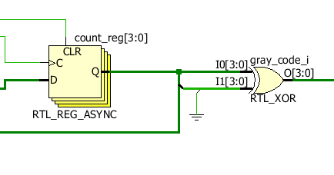
METHODOLGY
In a Gray code only one bit changes at a one time. This design code has two inputs clock and reset signals and one four bit output that will generate Gray code.

Slide 6
METHODOLGY(CONT..)
In the first if rst signal is high then output will be zero .
As soon as rst will go low, on the rising edge of clk, design will generate four bit Gray code and continue to generate at every rising edge of clk signal.
No 4 bit binary code greycode
0 0000 0000
1 0001 0001
2 0010 0011 ……. So on

Slide 7
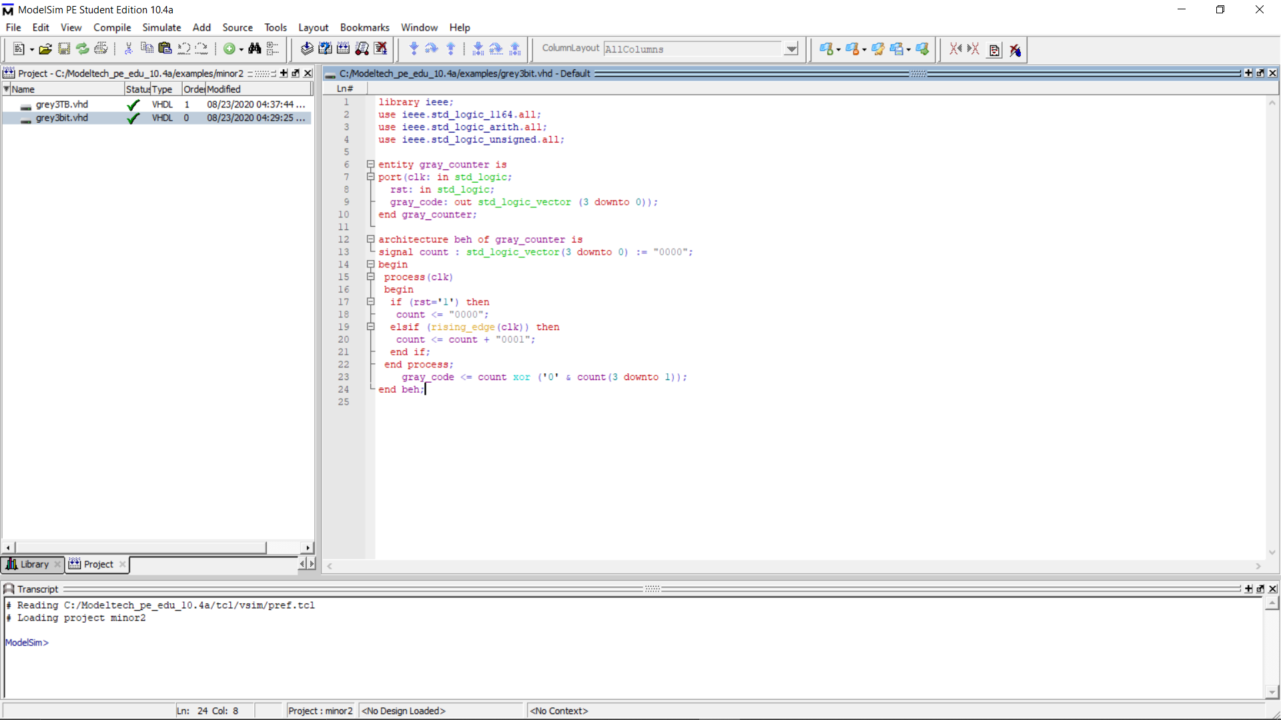
IMPLIMENTATION

Slide 8
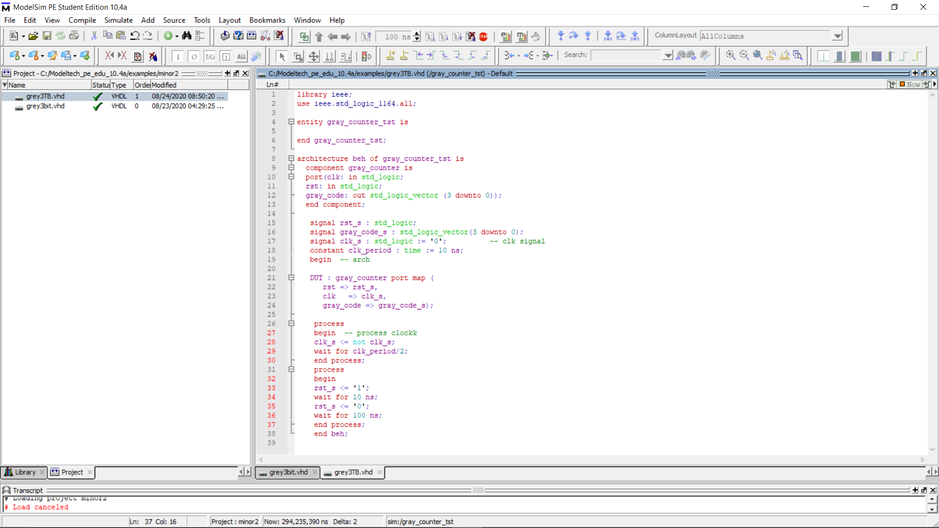
IMPLIMENTATION TESTBENCH

Slide 9
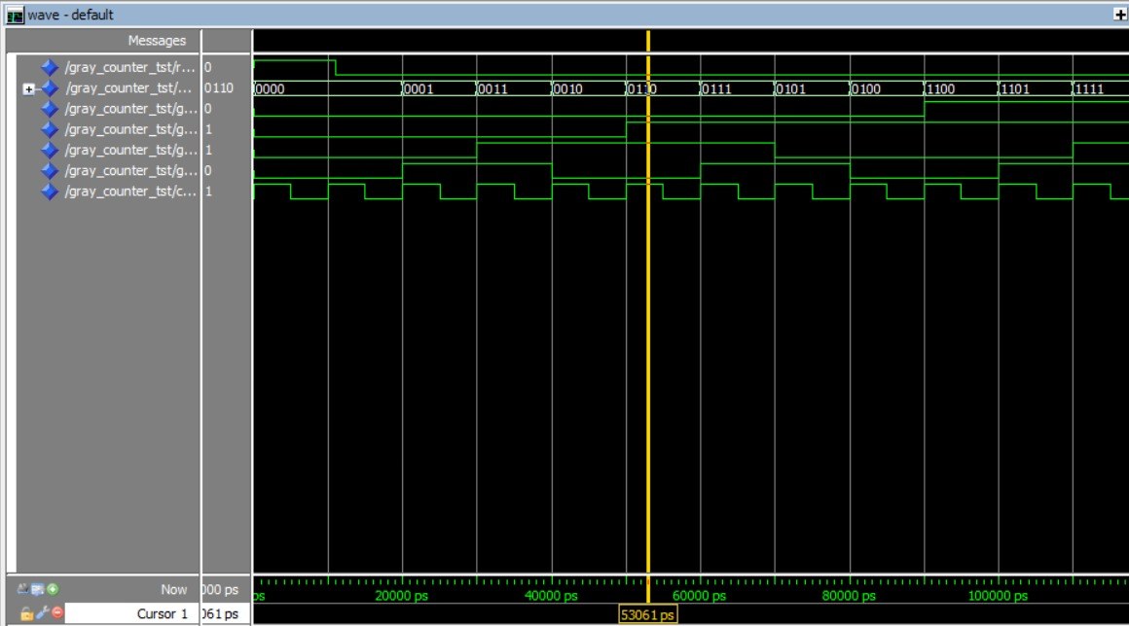
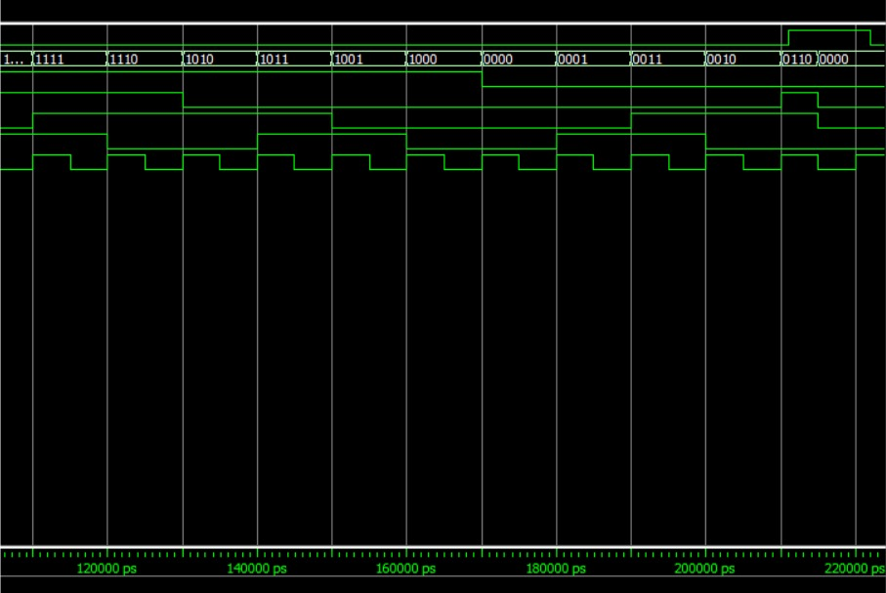
RESULTS

Slide 10
CONCLUSION
From this project we have learned how to design 4-bit grey coder using counter and using test bench.

Slide 11
REFERENCES
https://www.chegg.com/homework-help/questions-and-answers/1-design-3-bit-synchronous-gray-code-counter-enable-preset-outputs-follow-reflected-gray-c-q42232381
https://electronics.stackexchange.com/questions/26677/3bit-gray-counter-using-d-flip-flops-and-logic-gates

